Slide 1
CO226 Project
Project Proposal

Slide 2
80% Course Participation
According to IESL accreditation,
we all need it
to complete
our degree program.
Notes:
Trying to find a good pic for this help me out!!
As a
Trying to open up the problem here

Slide 3
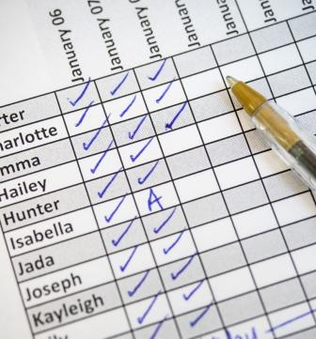
DO YOU HAVE
80 % attendance?
or
doesn't?
Notes:
Trying to find a good pic for this help me out!!
As a
Trying to open up the problem here

Slide 4
Unless a student recorded his or her own attendance,
It is a very hard process
to calculate their own attendance by themselves.
They can only know it a week before
the end exam.
Notes:
Trying to find a good pic for this help me out!!
As a
Trying to open up the problem here

Slide 5
What we need
or
What we can do ?
Notes:
Trying to find a good pic for this help me out!!
As a
Trying to open up the problem here

Slide 6
We need an
Online Database Management System
Notes:
Trying to find a good pic for this help me out!!
As a
Trying to open up the problem here

Slide 7
Is it only a database system ?
NO
Notes:
Trying to find a good pic for this help me out!!
As a
Trying to open up the problem here

Slide 8
2nd major problem related
to the attendance is,
“I will be missing/was missed a lecture, and I have a fair reason.”
But how I inform it ?
Notes:
Trying to find a good pic for this help me out!!
As a
Trying to open up the problem here

Slide 9
Our Solution
Can be marked by Instructors
student will be notified
via
Email(weekly)
Attendance
Can be checked by Students
using
Web-portal
Missed
Lecture
or
Lab
In case of
Student can provide
Valid reasons
Can be
Viewed by
Will miss
Lecturers and Instructors

Slide 10
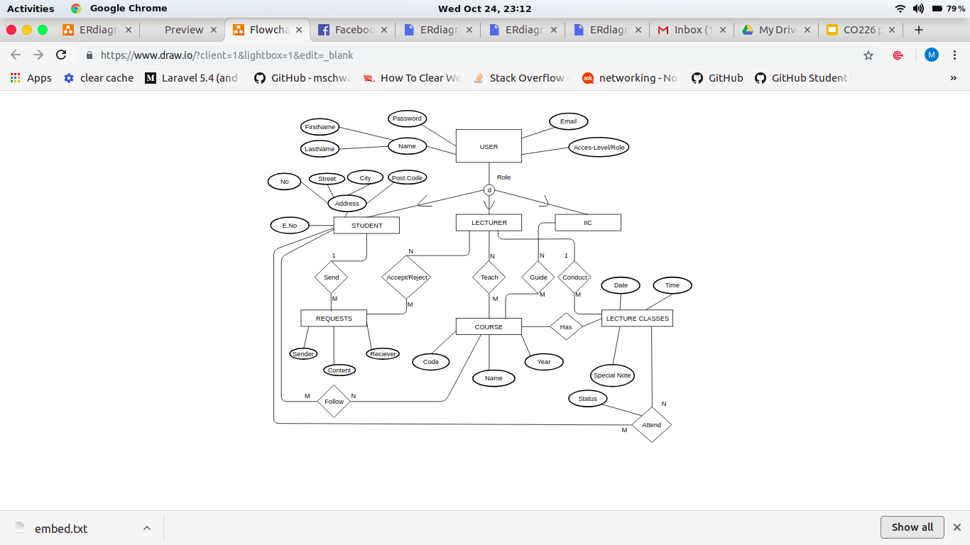
EER-diagram

